Slide 1
Upgraded PREPACQC QC Module:
Status and Resulting Changes
November 16, 2010

Slide 2
Why are we doing this?
Currently, NCEP has:
  PREPACQC for non-MDCRS aircraft data (AMDAR, AIREP, PIREP, etc)
  PREPACARSQC for MDCRS/ACARS data.
Naval Research Laboratory (NRL) aircraft data QC program:
  is more comprehensive then either of the above programs.
  QC’s all aircraft data types (one stop shopping… only have to maintain one QC module).
NRL code obtained from Dr. Pat Pauley, who also has provided help with getting it integrated into the NCEP processing stream.
As part of the new aircraft data QC package, a “mini-PREPBUFR” file containing aircraft profiles (ascents and descents) can be output for verification use.

Slide 3
Changes to /nwprod for this Implementation
Removal of ACARSQC QC module
  replaced by new, upgraded version of PREPACQC, which QCs all aircraft data
New, faster dump processing
Upgrade of PREPACQC itself

Slide 4
Removal of ACARSQC
(replaced by new, upgraded PREPACQC module)
New PREPACQC QCs all data from aircraft, including MDCRS/ACARS, AMDAR, TAMDAR, AIREP, etc.
  ACARSQC module is now redundant and can be deleted from the PREP processing.
Jobs in which ACARSQC variables are eliminated (in /nwprod/jobs):
  JCDAS_PREP1.sms.prod
  JCDAS_PREP2.sms.prod
  JGDAS_PREP.sms.prod
  JGFS_PREP.sms.prod
  JNAM_PREP.sms.prod
  JNDAS_PREP.sms.prod
  JRTMA_PREP.sms.prod
  JRUC2A_PREP.sms.prod
  JNAM_PCPN_ANAL.sms.prod
  JCDC_CDAS_PREP2.sms.prod
  JCDC_CDAS_PREP3.sms.prod
Scripts, parm cards, and codes that can be deleted:
  /nwprod/ush/prepobs_acarsqc.sh
  /nwprod/parm/prepobs_acarsqc.*.parm (where *=cdas, cdc, gdas, gfs, nam, ruc)
  /nwprod/sorc/preobs_acarsqc.fd/*

Slide 5
Upgraded Dump Processing
The new PREPACQC runs more slowly than the current one because it does more checks on the data.
  Needed to gain the time back via faster dump processing.
  Streamlining and rearranging the dump processing helped us to gain the time back.
  Dumps were split into 2 dump jobs for each network (global, NAM, RUC networks)
    “Regular dumps” = dumps of data needed for PREPBUFR processing.
    Non-PREPBUFR dumps were moved into “DUMP2” dump jobs.
      The PREP step does not need to wait on the “DUMP2” jobs to finish.

Slide 6
Upgraded Dump Processing (cont.)
Affected jobs:
  JGDAS_DUMP.sms.prod
  JGDAS_DUMP2.sms.prod
  JGFS_DUMP.sms.prod
  JGFS_DUMP2.sms.prod
  JCDAS_DUMP.sms.prod
  JNDAS_DUMP.sms.prod
  JNDAS_DUMP2.sms.prod
  JNAM_DUMP.sms.prod
  NAM_DUMP2.sms.prod
  JRUC2A_DUMP.sms.prod
  JRUC2A_DUMP2.sms.prod
Affected scripts:
  /nwprod/scripts/exglobal_dump.sh.sms
  /nwprod/scripts/exnam_dump.sh.sms
  /nwprod/scripts/exruc2_dump.sh.sms
  /nwprod/ush/bufr_dump_obs.sh
    Changes made in bufr_dump_obs.sh to speed up the construction of the dump “status” file, which lists data counts.

Slide 7
Upgrade of PREPACQC
Core QC code came from Pat Pauley at the Naval Research Lab (NRL)
EMC Obs/QC Working group wrote wrapper codes to allow the core QC code to run in an NCEP environment.
Benefits of integrating these codes into NCEP Ops:
  More thorough QC of meteorological data from aircraft
    more types of checks, especially more detailed track and position checking
  Codes were also written by Obs/QC working group to generate “raob-lookalike” profiles
    Will be used by air quality and verification groups in EMC.

Slide 8
Upgrade of PREPACQC (cont.)
Jobs affected: None
Scripts affected:
  /nwprod/scripts/exglobal_makeprepbufr.sh.sms
  /nwprod/scripts/exnam_makeprepbufr.sh.sms
  /nwprod/scripts/exruc2_prep.sh.sms
  /nwprod/ush/prepobs_prepacqc.sh
  /nwprod/ush/prepobs_makeprepbufr.sh
Fix files affected
  /nwprod/fix/prepobs_prep.bufrtable
Parm files affected
  /nwprod/parm/prepobs_prepacqc.*.parm (where * = cdas, cdc, nam, gfs, gdas, ruc)
Source affected:
  /nwprod/sorc/prepobs_prepacqc.fd

Slide 9
A couple of quick examples…
Observations with incorrect positions and/or time tags
Erroneous due north or south winds

Slide 10
Example #1: Incorrect positions and/or time tags
Cycle Time: 2006032200
Flight: NDXAOHKA Tail Number: SRIEC5RA
LAT/LON: 25.74 / 279.60 IDT: -1610 Z: 6171.00 P: 806.80 T: 287.46 Q: -9999.00 S: 14.36 D: 264.81
LAT/LON: 25.71 / 279.61 IDT: -1590 Z: 7192.00 P: 776.20 T: 286.26 Q: -9999.00 S: 14.37 D: 253.84
LAT/LON: 25.69 / 279.62 IDT: -1570 Z: 8199.00 P: 746.90 T: 284.26 Q: -9999.00 S: 10.26 D: 259.90
LAT/LON: 25.67 / 279.65 IDT: -1550 Z: 9180.00 P: 719.30 T: 282.26 Q: -9999.00 S: 12.28 D: 246.99
LAT/LON: 25.67 / 279.85 IDT: -1530 Z: 10112.00 P: 693.80 T: 280.26 Q: -9999.00 S: 13.37 D: 242.86
LAT/LON: 25.66 / 279.71 IDT: -1510 Z: 10630.00 P: 679.90 T: 279.46 Q: -9999.00 S: 10.74 D: 241.05
LAT/LON: 25.66 / 279.75 IDT: -1490 Z: 10899.00 P: 672.80 T: 278.96 Q: -9999.00 S: 11.31 D: 231.10
LAT/LON: 25.66 / 279.79 IDT: -1470 Z: 11490.00 P: 657.50 T: 277.76 Q: -9999.00 S: 10.75 D: 225.00
Temperature and winds from this report were marked as good (QM=1) by ACARSQC (current aircraft QC module for MDCRS aircraft data).
NRLACQC QC module marks the temperature and winds as bad (QM=13) because of the odd longitude.
  Subroutine ordchek (track check code) marked this observation as bad

Slide 11
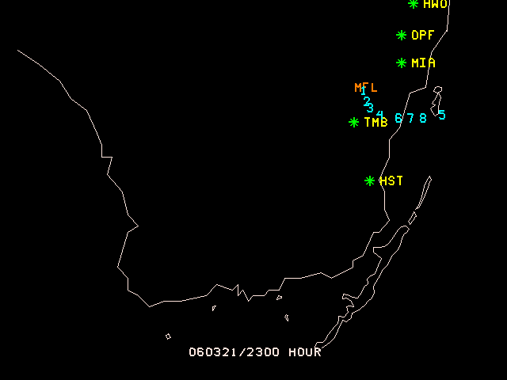
Example #1: Incorrect positions and/or time tags (cont.)

Slide 12
Example #2a: Erroneous due south winds
Cycle Time: 2006032212
Flight: F2OQUSJA Tail Number: DQZHL5RA
LAT/LON: 36.13 / 273.34 IDT: 2280 Z: 236.00 P: 1004.60 T: 272.96 Q: -9999.00 S: 2.06 D: 337.17
LAT/LON: 36.13 / 273.34 IDT: 2340 Z: 715.00 P: 987.30 T: 272.06 Q: -9999.00 S: 2.63 D: 351.25
LAT/LON: 36.14 / 273.34 IDT: 2340 Z: 1053.00 P: 975.20 T: 270.76 Q: -9999.00 S: 2.60 D: 180.00
LAT/LON: 36.14 / 273.35 IDT: 2340 Z: 1634.00 P: 954.80 T: 268.56 Q: -9999.00 S: 3.58 D: 22.99
LAT/LON: 36.15 / 273.35 IDT: 2340 Z: 1844.00 P: 947.50 T: 267.26 Q: -9999.00 S: 4.62 D: 355.03
LAT/LON: 36.15 / 273.36 IDT: 2340 Z: 2136.00 P: 937.40 T: 266.26 Q: -9999.00 S: 5.74 D: 7.00
Both temperature and winds were marked as good (QM=1) by PREPACARSQC (current aircraft QC module for MDCRS aircraft data).
NRLACQC QC module marks the wind in this observation as bad (QM=13) because of the incorrect due south wind. Temperature is marked as good (QM=1).

Slide 13
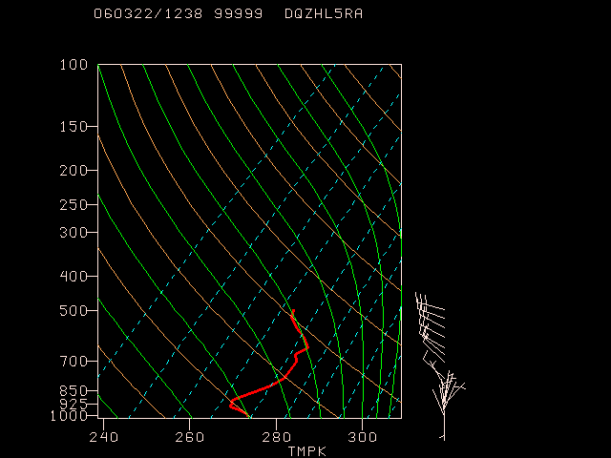
Example #2a: Erroneous due south winds (cont.)

Slide 14
Example #2b: Erroneous due north winds (cont.)
Flight: EU2800 Tail Number: MISSING
LAT/LON: 48.79 / 9.22 IDT: -4140 Z: 2297.00 P: 931.90 T: 273.76 Q: -9999.00 S: .50 D: 360.00
LAT/LON: 48.79 / 9.22 IDT: -4140 Z: 2657.00 P: 919.70 T: 272.96 Q: -9999.00 S: 1.00 D: 360.00
LAT/LON: 48.79 / 9.22 IDT: -4140 Z: 3051.00 P: 906.40 T: 272.76 Q: -9999.00 S: 2.60 D: 360.00
LAT/LON: 48.79 / 9.21 IDT: -4140 Z: 3543.00 P: 890.10 T: 272.96 Q: -9999.00 S: 1.00 D: 360.00
LAT/LON: 48.79 / 9.21 IDT: -4140 Z: 4167.00 P: 869.70 T: 272.96 Q: -9999.00 S: 2.12 D: 289.29
LAT/LON: 48.81 / 9.21 IDT: -4080 Z: 4724.00 P: 851.80 T: 273.76 Q: -9999.00 S: 4.10 D: 268.60
LAT/LON: 48.81 / 9.19 IDT: -4080 Z: 5282.00 P: 834.20 T: 272.96 Q: -9999.00 S: 6.20 D: 269.08
LAT/LON: 48.82 / 9.19 IDT: -4080 Z: 5741.00 P: 819.90 T: 271.96 Q: -9999.00 S: 7.20 D: 269.21
LAT/LON: 48.82 / 9.19 IDT: -4080 Z: 6070.00 P: 809.90 T: 272.76 Q: -9999.00 S: 8.20 D: 269.30
LAT/LON: 48.82 / 9.19 IDT: -4080 Z: 6332.00 P: 801.90 T: 271.76 Q: -9999.00 S: 9.30 D: 268.77
LAT/LON: 48.82 / 9.19 IDT: -4080 Z: 6693.00 P: 791.00 T: 270.76 Q: -9999.00 S: 9.80 D: 268.83
LAT/LON: 48.82 / 9.19 IDT: -4020 Z: 7251.00 P: 774.40 T: 269.76 Q: -9999.00 S: 10.80 D: 268.94
Both temperature and winds were marked as good (QM=1) by PREPACQC (current aircraft QC module for AMDAR aircraft data).
NRLACQC QC module marks the due north winds in this observation as bad (QM=13) because of the incorrect due south wind. Temperatures are marked as good (QM=1).

Slide 15
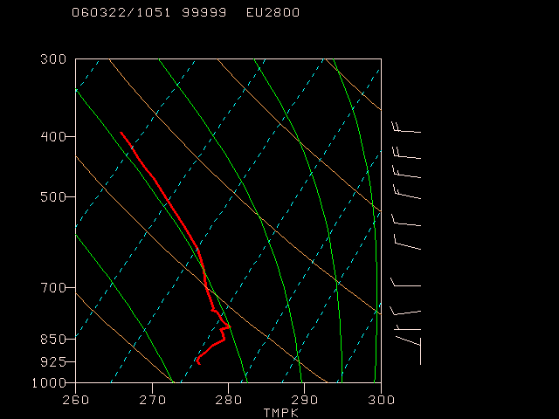
Example #2b: Erroneous due north winds (cont.)

